Slide 1



Designing Artificial Moral Agents

Slide 2
Understanding the Challenges, Principles, and Implementation
Designing AMAs
Artificial Moral Agents
Value Alignment
Ethical Background
Implementation Challenges

Slide 3
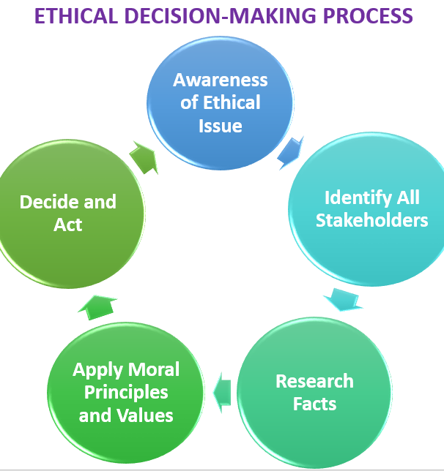
Artificial Moral Agents
Definition: AMAs are AI systems capable of moral reasoning.
Purpose: Ensure AI decisions align with societal and ethical principles.
Image: A flowchart showing the ethical decision-making process in AI.
3

Slide 4
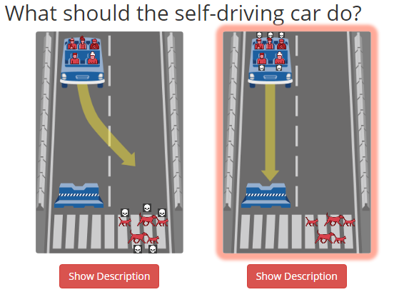
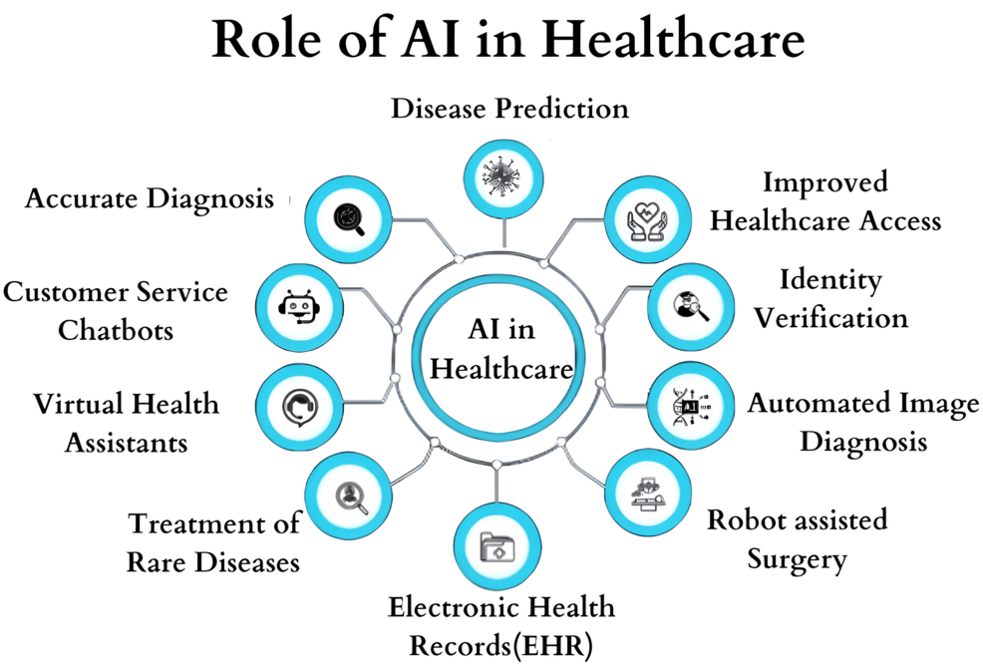
Example : A doctor using an AI diagnostic tool to interpret medical data while retaining final decision-making authority.
Example : A self-driving car deciding whether to prioritize passenger safety or pedestrian safety in an unavoidable accident scenario.
4

Slide 5


Value Alignment: Identify ethical principles and human values.
Ethical Background: Choose ethical theories for implementation.
Implementation: Define autonomy, user roles, and governing institutions.
Key Steps in Designing AMAs
Definition: Autonomy refers to the ability of an AI system to make decisions independently, without human intervention, based on predefined ethical principles and reasoning frameworks.
Definition: User roles define how humans interact with the AI system, including their responsibilities, permissions, and level of control.

Slide 6
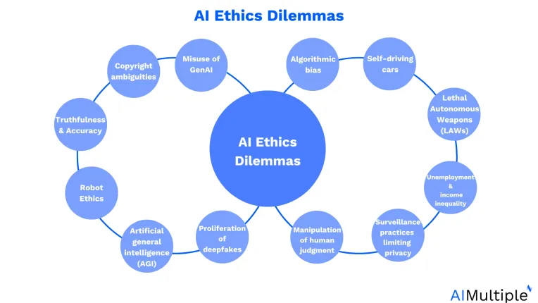
Value Alignment
Which values will the AI follow? Safety, fairness, privacy, etc.
Who decides these values? Governments, businesses, researchers, and the public.
Prioritization dilemma: AI must balance conflicting values (e.g., should a self-driving car protect passengers or pedestrians in an accident?)
Example : A diagram showing ethical dilemmas in AI.
6

Slide 7
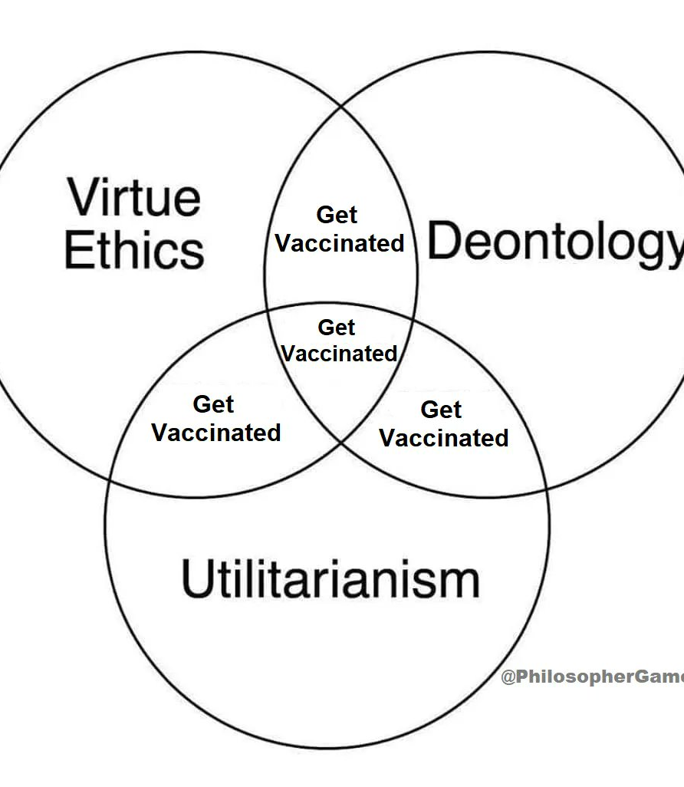
Ethical Background in AI
Different ethical theories AI can follow:
Utilitarianism: Chooses the action that benefits the most people.
Deontology: Follows fixed moral rules, no matter the outcome.
Virtue ethics: Considers the morality of the decision-maker.
Who decides the approach? AI designers and policymakers must make informed choices.
7

Slide 8


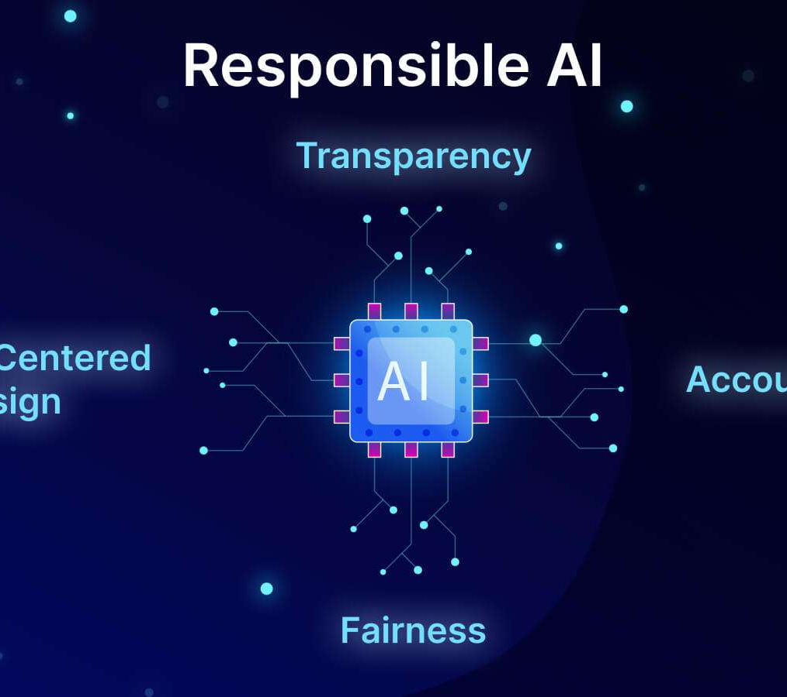
Implementation Challenges
Level of AI autonomy: Should AI act independently, or should humans always oversee it?
User role:
Should AI give recommendations or make final decisions?
Government regulation:
Laws must ensure AI acts ethically and fairly.
8

Slide 9
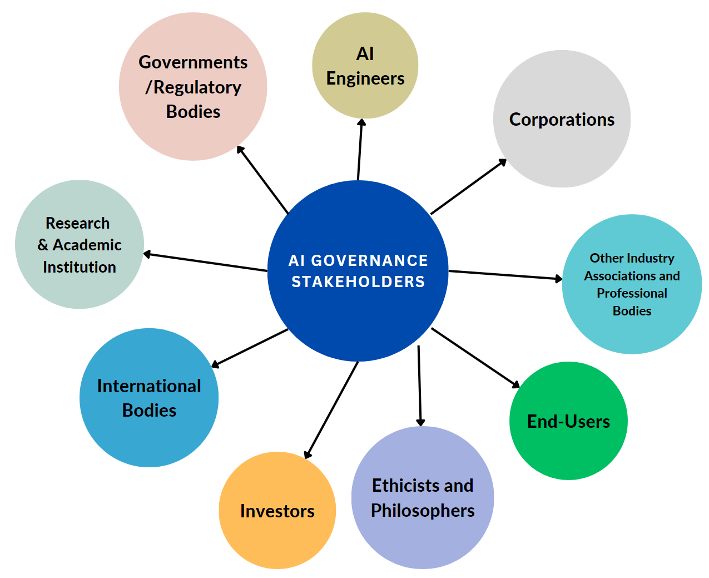
Who Sets the Values?
Stakeholder participation is crucial: AI must reflect the values of all affected groups.
Cultural differences matter: Different societies prioritize different ethical principles.
Example: Some cultures prioritize community well-being, while others emphasize individual rights.
9

Slide 10






Key Considerations in Value Setting
Involvement
Legitimacy
Electoral System
Rules for consultation and decision-making.
Crowd
Choice
Information
Who is consulted? Is the sample diverse?
Binary vs. spectrum of options.
How questions are framed.
Equal voting vs. unequal impact.
Majority decisions and acceptance.

Slide 11
Key Considerations in AMA Design
Crowd
Question: Who is included? Are stakeholders diverse (e.g., age, culture, profession)?
Example: MIT Moral Machine experiment revealed cultural biases in ethical preferences.
Risk: Human data perpetuates unconscious biases (e.g., gender/racial stereotypes).
2. Choice
Binary vs. Spectrum: Simplistic choices distort outcomes.
Trolley Problem: Binary decisions oversimplify moral complexity.
3. Information
Question Design: Wording influences answers.
Example: Same news can be differently written in different news papers that may maniplate the readers
4. Involvement
Equal Voting ≠ Equal Impact:
Example: classical trolly problem everyone in the scenario should participate to take decision
11

Slide 12
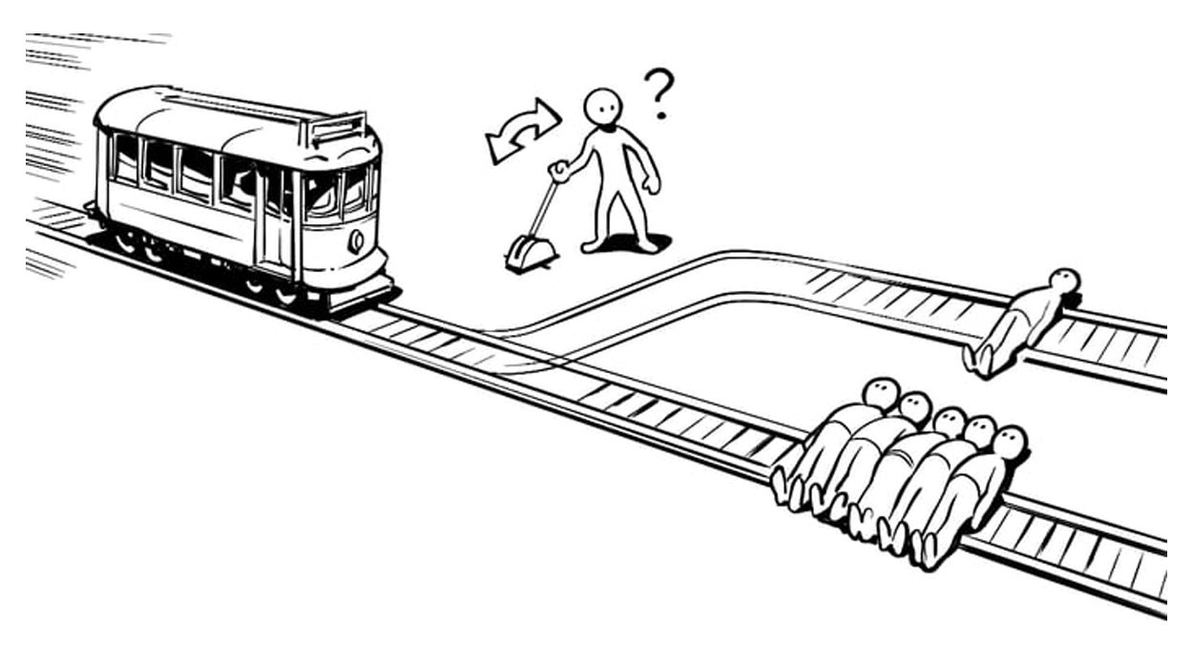
Classical Trolly Problem

Slide 13
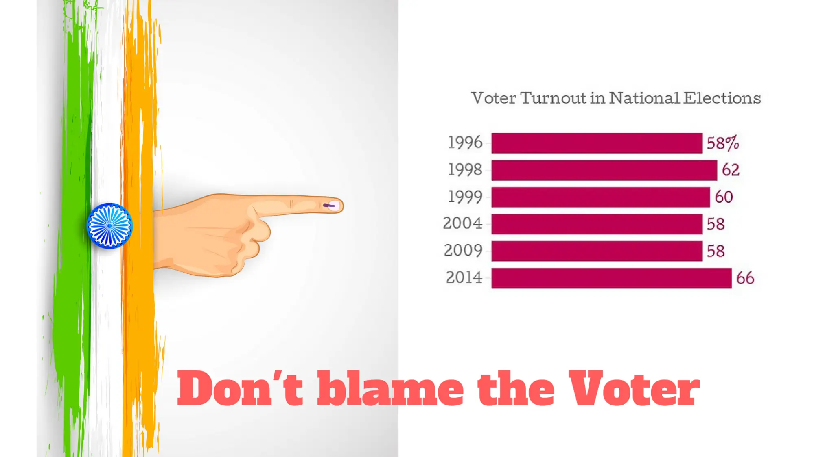
Legitimacy Challenges
Problem occurs at narrow marginal results
Voting Influences:
Social Identity: Decisions based on group loyalty, not facts (e.g., partisan voting).
External Factors: Weather, misinformation, or voter fatigue skew participation.
Example: Low turnout in rainy elections affecting results.
Majority Rule ≠ Acceptance: Narrow margins (e.g., 51% vs. 49%) can undermine trust.
Example: 2016 Brexit referendum (52% Leave vs. 48% Remain) led to prolonged societal division.

Slide 14
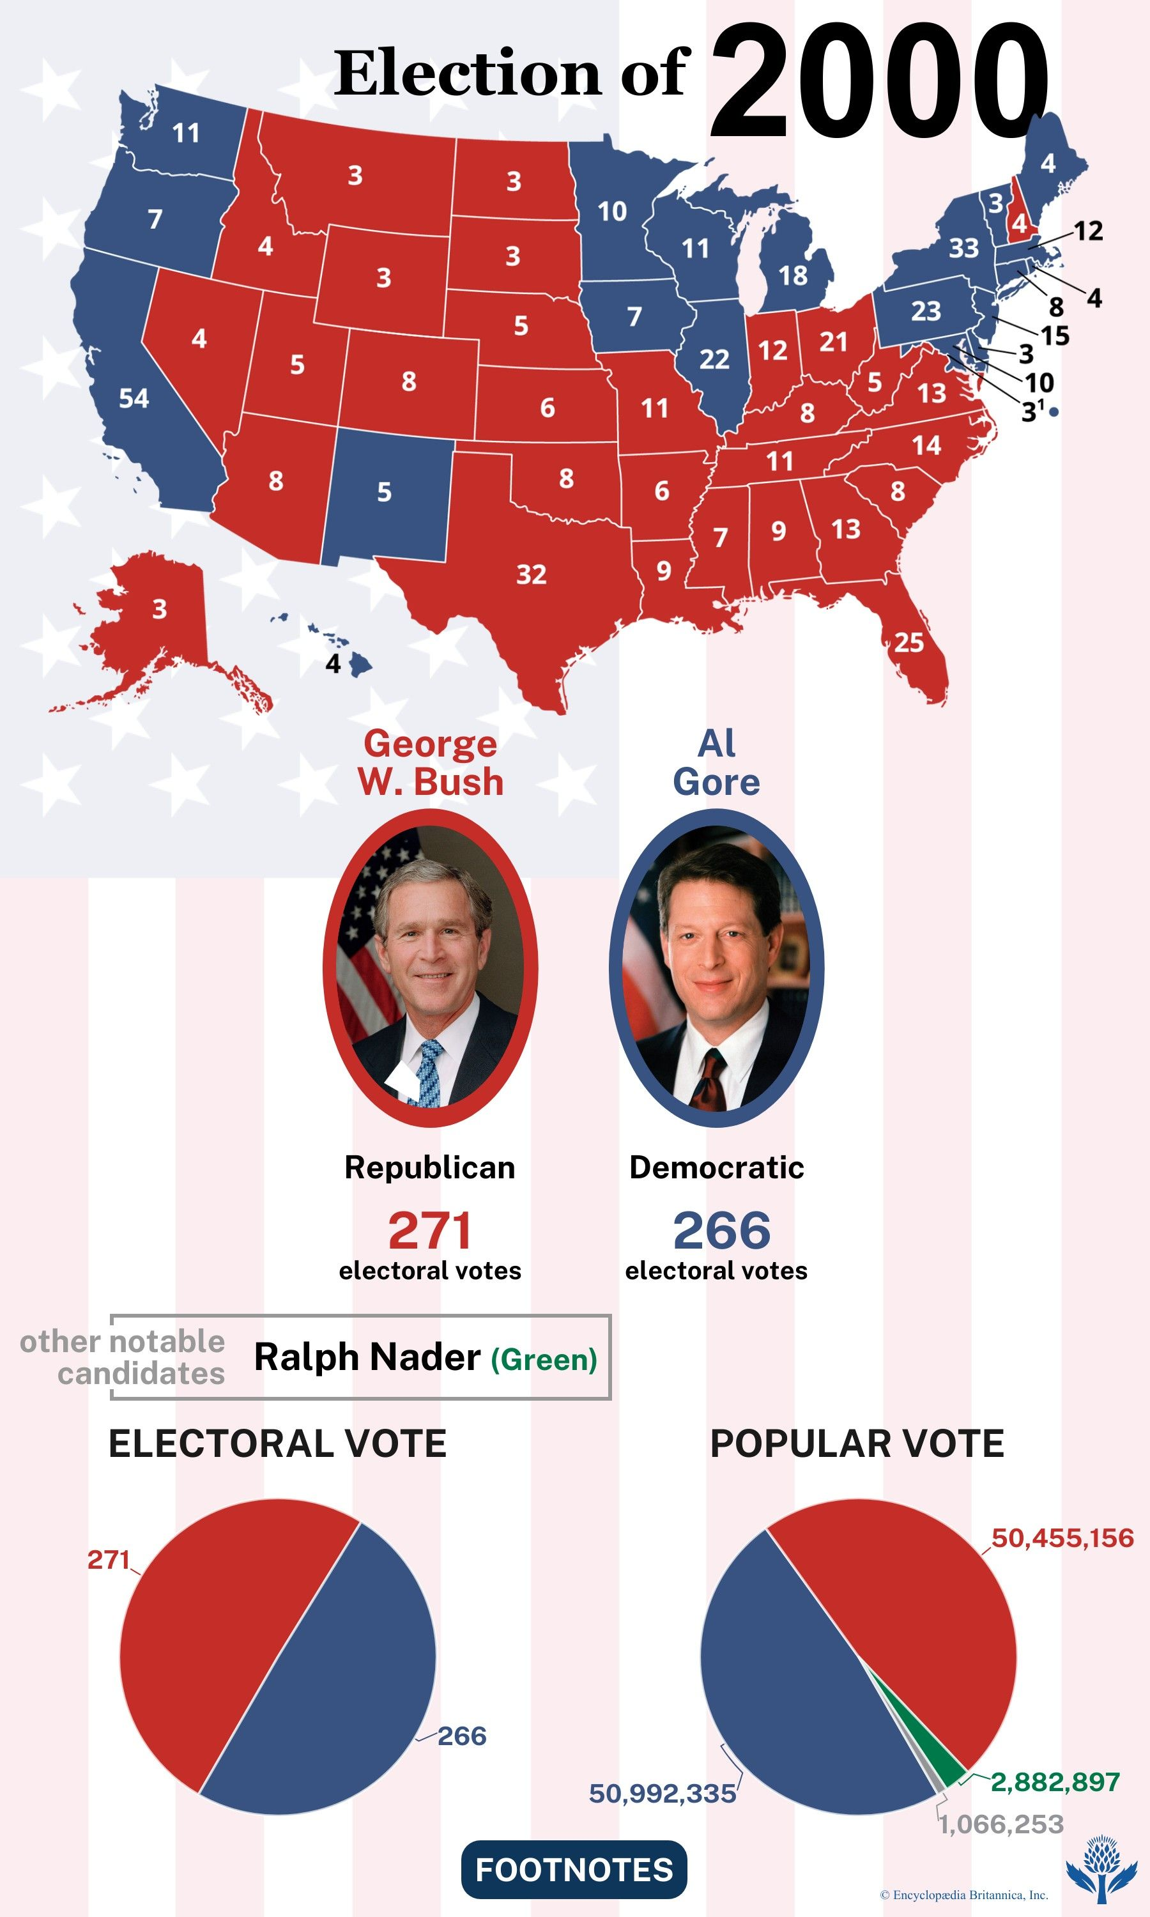
Electoral System Design
This is defined as the set of rules that determines How groups are consulted
How elections and referenda are conductedhow their results are calculated.
The way this system is set up determines for a large part the results.
Example:
Plurality Systems (Winner-Takes-All): Favors majority, risks marginalizing minorities.
Proportional Systems: Reflects electorate diversity.
Example: New Zealand’s MMP system ensures minority parties gain parliamentary seats.

Slide 15
Moral Machine Experiment
The Moral Machine experiment was an online platform created by MIT in 2016 to explore ethical decision-making in autonomous vehicles.
It presented users with scenarios where a self-driving car had to choose between different outcomes in unavoidable accident situations.
These choices often involved moral dilemmas, such as deciding whether to sacrifice pedestrians or passengers, prioritize the young over the elderly, or choose humans over animals.
Findings
Different cultures had varying ethical biases. For example:
Western countries tended to prioritize saving younger people.
Some countries placed a higher value on saving law-abiding individuals over criminals.
There were variations in how much people valued human life over animals.

Slide 16
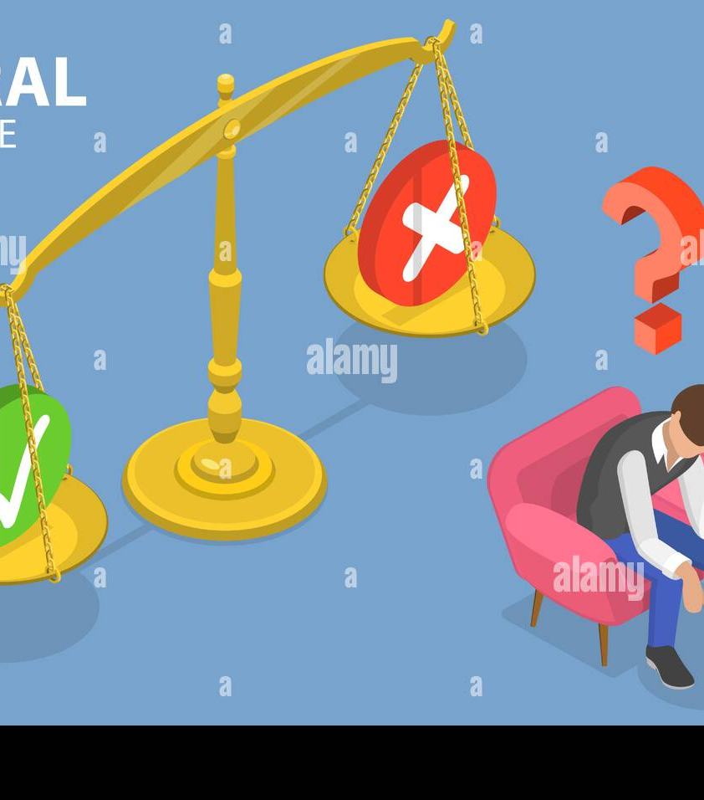
Framework for Ethical Deliberation
Fishkin’s
principle
Information: Provide clear, unbiased data (e.g., explain trade-offs in AI decisions).
Substantive Balance: Compare different positons evidence (e.g., Modern development vs Nature preservation).
Diversity: Include marginalized voices (e.g., rural communities in peace negotiations).
Conscientiousness: Participants sincerely weigh all arguments.
Equal Consideration: Weigh arguments, not identities.
Openness: Document design choices (e.g., why a self-driving car prioritizes pedestrians).
16

Slide 17




Thank you

